Slide 1
Basic Aerodynamics for the Sailplane pilot

Slide 2
Topics
Forces acting on the sailplane
Stability and control
Sailplane performance

Slide 3
Aircraft Axes

Slide 4
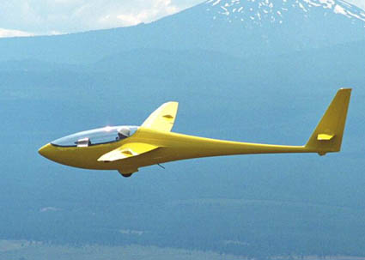
Forces acting in straight glide
Lift
Drag
Relative Wind
Weight
Lift acts on the center of pressure (CP). Its direction is perpendicular to the relative wind.
Weight acts on the center of gravity. Its direction is towards the earth’s center.
Drag acts on the center of gravity. Its direction is parallel to the relative wind.
Thrust (if any-e.g. motorglider) acts on the CG. Its direction is parallel to the relative
wind (opposite drag).

Slide 5
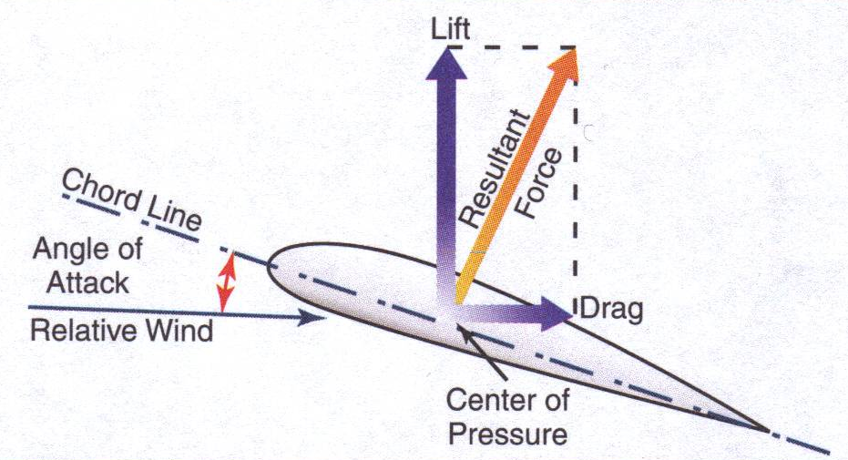
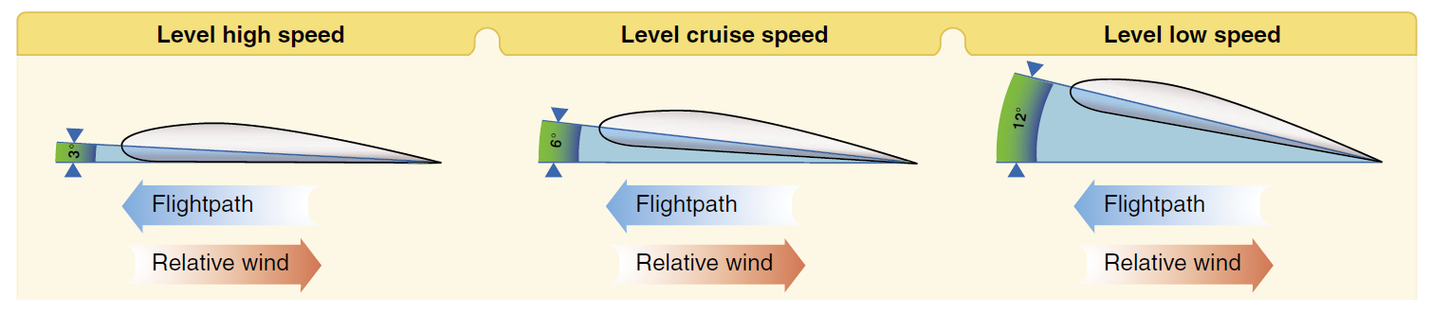
Angle of Attack

Slide 6
Aside: How much “thrust” does a sailplane need?
Thrust=Weight x sin(α)
Example: SGS 1-26, weighing 700 lb (320 kg)
Sink: 1 m/s
Airspeed: 28 m/s [62 MPH (100 km/h)]
α=ATAN(1/28)=6 degrees
Thrust=320 kg 9.8 m/s^2x sin(6)=113 N
Power=Thrust*Velocity=113N x 28 m/s
= 3100 W, or ~4 HP
CG
Thrust
α
Weight
Relative Wind
“Thrust” component
Since the sailplane is descending through the air around it, the relative wind meets the airframe at an angle (α) from below. The component of weight that is parallel to the relative wind is “thrust.”

Slide 7
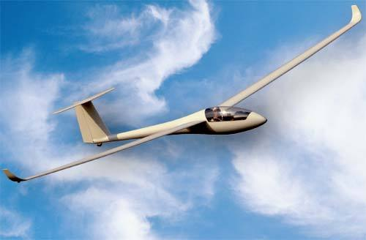
Coordinated Turning Flight
Lift
Weight
Relative Wind
In a gliding turn to the right, the relative wind is from below right of the glider. Lift is perpendicular to the relative wind, so its direction is up and to the right, relative to the glider. The component of lift that acts to the right “pulls” the glider in a circle to the right.

Slide 8
Turning forces relative to glider
Right-turning force
Lift
Glider is flying towards you…
Relative Wind
Weight
Lift (acting perpendicular to relative wind) can be decomposed into a portion that opposes the weight of the glider and a portion that acts towards the inside of the turn. The portion acting towards the center of the turn is what causes the glider to turn. Banking the wings causes the lift force to “tilt” in the direction of the turn, which causes the glider to be “pulled” into the turn.

Slide 9
Adverse Yaw
Rolling into a right turn:
Rudder is used to counteract adverse yaw
“down” aileron=increased lift=increased induced drag
“up” aileron=reduced lift=reduced induced drag
Nose yaws left (“adverse” to the direction of the turn)
Adverse yaw is more noticeable in a sailplane than in most airplanes due to the much longer moment arm of the ailerons, combined with greater aileron deflection in the sailplane. Note that adverse yaw is only present when rolling into or out of a turn, not in established turning flight.

Slide 10
Overbanking Tendency
Outside wing moves faster=more lift
Inside wing moves slower=less lift
Speed difference between inside and outside wings causes outside wing to produce more lift, which tends to increase bank angle. In shallow turns, stability (desire to return to level flight) dominates this effect, but in medium banks overbanking dominates lift and opposite aileron application is necessary to prevent overbanking.

Slide 11
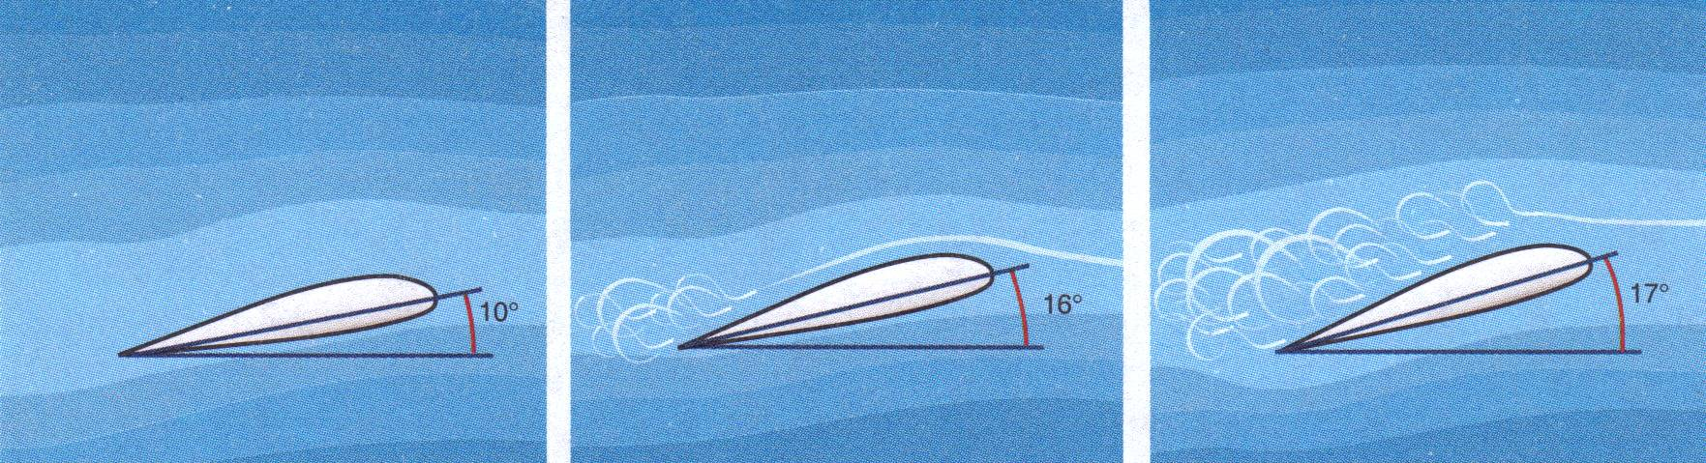
Stalls and Spins
An airplane can be stalled at any airspeed and in any flight attitude. A stall results when the critical angle of attack is exceeded and the smooth airflow over the airplanes wing is disrupted. The critical angle of attack at which an airplane stalls will be the same regardless of airspeed, weight, or configuration.
Normal Flight
Incipient Stall
Stall
An airplane in a given configuration will stall at the same indicated airspeed regardless of altitude because the airspeed indicator is directly related to air density
An airplane spins when one wing is more stalled than the other. To enter a spin an airplane must be stalled first.

Slide 12
Stall Progression

Slide 13
Stability

Slide 14
Stability-Defined
An inherently stable airplane returns to its original condition (Position or attitude) after being disturbed. It requires less effort to control.
Generally, longitudinal stability is the major concern for aircraft designers
Stability around the vertical axis is provided by the empennage
Most airplanes and gliders are only marginally stable in the lateral axis in order to keep turning forces minimal

Slide 15
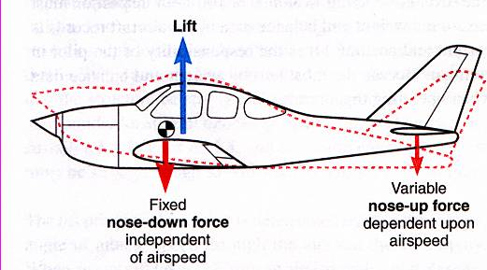
Longitudinal Stability
The location of the center of gravity (CG) with respect to the center of lift ( or center of pressure) determines the longitudinal stability of an airplane or glider
In order to be longitudinally stable, the CG must be in front of the center of pressure, because this allows the variable down-force of the horizontal stabilizer to counteract any longitudinal pitching moments.
Imagine an upward gust hitting the glider. The nose will pitch up, because the gust force acts on the CG, which is ahead of the CP. The pitch up of the nose decreases the angle of attack of the horizontal stabilizer, which reduces the tail-down force, causing the tail to rise and bringing the nose back down. The glider automatically tries to return to the pre-gust angle of attack. This means the glider is longitudinally stable.
As the glider is loaded, if the CG location moves aft, longitudinal stability will be decreased

Slide 16
Sailplane Performance

Slide 17
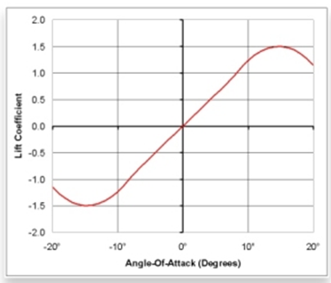
Lift
Lift=0.5*Cl *(Air Density)*(Airspeed)^2*(Wing Area)
Where Cl=Coefficient of Lift (depends on airfoil, AOA, and Reynolds number)
E.g. Symmetrical Airfoil (Cl is zero at 0 AOA, slopes at 0.11 /deg and peaks at 15 AOA):
Stall
Let’s calculate the lift force at 10 degrees AOA:
Lift=0.5 * 1.1 * 0.0025 (slugs/ft^3) * (75 ft/sec)^2* 240 ft^2
=1860 pounds. If your glider weighs 1000 pounds, you’ll have 860 slugs(pounds) accelerating you upward.
Inverted Stall
Example is NACA 0012 airfoil

Slide 18
Drag
Total drag is a combination of induced drag and parasite drag. Induced drag is the drag caused by the production of lift , while parasite drag is caused by the resistance of the air to the sailplane flying though it.
Parasite Drag: Imagine wind blowing on a flat plate. The plate will feel a force acting parallel to the wind direction. This is the parasite drag of the plate. The faster the wind is moving, the greater the force.
Plate
Wind
Parasite Drag

Slide 19
Induced Drag
Induced drag is drag that is caused by the production of lift. There are principally two ways of thinking about induced drag:
Positive angle of attack inclines the lift vector such that the force produced by the wing has both an upward component (lift) and a rearward (i.e. parallel to the relative wind) component:
Induced Drag
Lift (perpendicular to r. wind)
Total force produced by the wing
AoA
Relative Wind
2. At the ends of the wings, the pressure difference between the top and bottom of the wings creates vortices. Creating these vortices takes energy, which results in induced drag.

Slide 20
Why do Gliders have long, slim wings?
High “aspect ratio” (length much greater than width)
Low “aspect ratio” (length and width are similar)
A high aspect ratio wing has less width at the tip than a low aspect wing of equivalent surface area. Since the vortices that cause induced drag are produced at the wing tips, having less tip area creates smaller vortices, and therefore reduces induced drag.
Thus, a high aspect ratio wing will produce lower induced drag than a low aspect ratio wing of equivalent surface area.

Slide 21
Lift-Weight Equivalence
In a steady glide condition the lift has to equal the weight of the glider.
If the lift was greater than the weight, the glider would be accelerating upward
Even in a climb, the glider is still descending relative to the air around it, it’s just that the air is rising faster than the glider is sinking
It is possible to accelerate upward in a glider by trading upward acceleration for airspeed, but this cannot be maintained very long before a stall occurs

Slide 22
Relationship of Induced Drag to A/S
Recall that Lift=0.5*Cl *(Air Density)*(Airspeed)^2*(Wing Area), so that as airspeed increases, the lift also increases. However, lift must equal weight , so as airspeed increases the Lift Coefficient must decrease. The usual way to decrease the Cl is to decrease the angle of attack:
Now, remember that induced drag is proportional to angle of attack (recall the rearward-tilting force from the wing). So, as airspeed increases the angle of attack decreases, and therefore the induced drag decreases as well

Slide 23
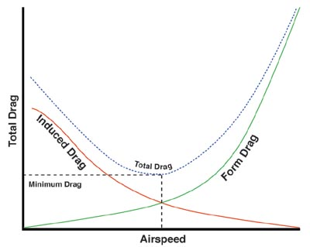
Total Drag Curve
Now we know that parasite drag increases with airspeed (remember the wind blowing on the plate), and that induced drag decreases with airspeed (due to the rearward force vector from the wing). Total drag is equal to the sum of induced drag and parasite drag, and the total drag curve thus looks like this:
Parasite Drag
For more info on drag, see: http://web.mit.edu/16.unified/www/FALL/thermodynamics/notes/node99.html

Slide 24
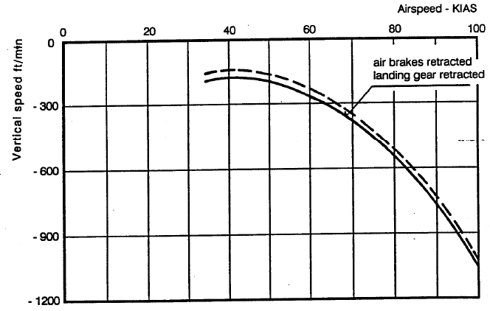
The Glider’s Polar Curve
A plot showing the sink rate plotted against the airspeed is called the glider’s “polar” curve. This can be computed from the total drag curve, but we won’t do that here.

Slide 25
Speeds to Fly
Two speeds are of principal interest to glider pilots:
The speed to fly in order to sink the slowest (useful in thermalling and trying to extend flight time)
The speed to fly in order to go the greatest distance over the ground (useful in X/C or for getting back to the field if low)
With no wind, the speed to fly to cover the most distance is equivalent to the maximum L/D for the glider
Glider pilots tend to use the term “Best L/D” interchangeably with “speed to fly for maximum distance”, even though best L/D is an aerodynamic property
Both of these speeds vary with glider weight, load factor, and configuration (e.g. landing gear extended/retracted, wing tips installed or not)
Best glide speed also varies with wind, since you’re concerned with covering distance over the ground

Slide 26
Minimum Sink Speed
Minimum Sink Speed
Minimum Sink Rate
The minimum sink rate is determined by drawing a horizontal line tangent to the polar curve. The speed where this line touches the curve is the minimum sink speed.

Slide 27
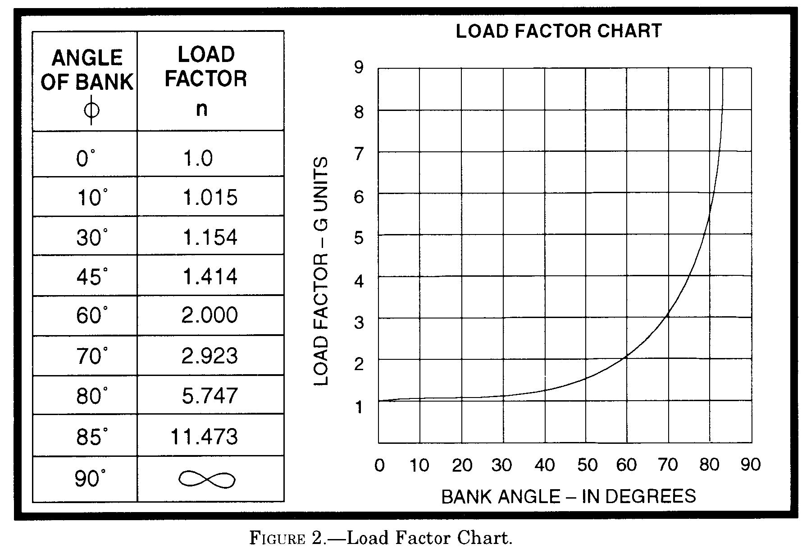
Effect of Load Factor on Minimum Sink
Minimum sink speed increases as the load factor increases.
Load factor in straight and level, unaccelerated flight is 1.0, but a turn increases the load factor
As the load factor goes up, the minimum sink speed rises as the square root of the load factor. For example, for load factor of 2.0, the minimum sink speed will be 1.4 times the minimum sink speed in level flight

Slide 28
Best L/D Speed
Best L/D Speed
The best L/D speed is found by drawing a line from the origin that is tangent to the polar. The speed where this line intersects the polar is the best L/D speed.

Slide 29
Best Glide Speed
In no-wind conditions, best L/D will give you the greatest distance over the ground
With a headwind or tailwind, this needs to be adjusted:
Fly faster into a headwind
Slow down with a tailwind
To determine the precise speed, use same method as best L/D, but start along the horizontal axis at a point other than the origin:
For headwind, start to the right of the origin
For tailwind, start to the left of the origin
Tailwind
Headwind

Slide 30
Example: 10-knot tailwind
Start at -10 kts
Draw straight line tangent to polar
Draw vertical line up to read the speed to fly
~46 Kts
10

Slide 31
Example: 10-knot headwind
Start at 10 kts
Draw straight line tangent to polar
Draw vertical line up to read the speed to fly
~51 Kts
10

Slide 32
Best Glide Speed in Lift or Sink
In areas of lift or sink, the best glide speed will be different from that of still air:
Speed up in sink, slow down in lift
One wants to spend as much time as possible in rising air, in order to get the most “boost”, while in sink one wants to get out as soon as possible.
The best speed to fly can again be found from the polar, by adjusting the starting point of the tangent line vertically based on the amount of lift or sink:
Sink: starting point moves up
Lift: starting point moves down

Slide 33
Example: 300 fpm lift
Start at -300 fpm
Draw straight line tangent to polar
Draw vertical line up to read the speed to fly
~38 Kts
10
Note that for strong lift, you must consider a safe margin above stalling speed and may not want to fly as low as the “theoretical” speed to fly would suggest

Slide 34
Summary:
Sailplanes generally have long, thin wings (high aspect ratio) because this produces the least induced drag for a given amount of lift required
A stall occurs when the critical angle of attack is exceeded. It does NOT occur at a fixed airspeed.
Longitudinal stability is a primary concern in sailplane design. The position of the wing with respect to the cabin and tail is decided based on the need to keep the CG in front of the center of lift. This design CG range can be exceeded if loaded improperly.
Overbanking tendency occurs when lift difference between inner (slower moving) and outer (faster moving) wings exceeds built-in lateral stability.
Speeds to fly:
Best glide: faster than best L/D if in headwind, sink; slower than best L/D in tailwind/lift
Thermalling: Minimum sink speed for angle of bank being used (for 45 degree bank angle, this is 1.4 times straight ahead min. sink).

